Slide 1

DAYANANDA SAGAR UNIVERSITY
SCHOOL OF ENGINEERING
Department of Computer Science and Technology
SIGN LANGUAGE TRANSLATOR USING DEEP LEARNING
Under the Supervision
Prof. Rashmi Mothkur
Presented By:
B. Evans Nikith Royan(ENG18CS0054)
Darryl R. Andrade (ENG18CS0079)
Davin S. Thomas (ENG18CS0082)
Debjit Das (ENG18CS0083)
Gyandwip Das (ENG18CS0109)
Notes:
Title of the project
CSE Dept., SET-Jain University
‹#›

Slide 2
Overview
Abstract
Problem Statement
Introduction
Social/Environmental Impact
State of the Art work
Design
Methodology
Experimentation
Testing and Results
References
Dept of CSE., SOE-Dayananda Sagar University
*

Slide 3
Abstract
More than 466 million people worldwide have deafness or hearing loss (>5% of the world population).
Sign Languages allow dumb and deaf people to communicate with each other and the rest of the world. There are over 135 different sign languages around the world.
Not everybody is literate in Sign Language.
A Sign Language Translator would be key to bridge the gap between Sign Language Speakers and Native Speakers.
The aim is to build a translator that will help Non Sign Language Speakers interpret Sign Language.
Dept of CSE., SOE-Dayananda Sagar University
*
Notes:
Give only key points
Do not write paragraph
Why this work
What you plan to do
How will you do-Approach
What we can expect as result

Slide 4
Problem Statement
Sign language is the means of communication for people who are speech and hearing impaired.
However, people who cannot understand sign language will most definitely find it hard and even impossible to understand what another person is saying to them in sign language.
The proposed model will help to find a solution that would help non-sign-language speakers to identify gestures used in Sign Language.
Dept of CSE., SOE-Dayananda Sagar University
*
Notes:
A problem statement is usually one or two sentences to explain the problem your process improvement project will address.
A problem statement should include a user, a need/ pain point and a goal/ reason.
Eg:
Problem: “Going to the video store requires fighting traffic, wandering the aisles, and waiting in long lines just to get a single movie.”
Solution: “Netflix allows anyone to enjoy thousands of titles streamed directly to their home or delivered to their mailbox.”

Slide 5
Introduction
The aim is to build an application that can translate a range of sign language gestures.
The proposed approach is to make use of a Deep Learning Model to develop a translator that can output a fully understandable translation on being fed sign language gestures.
The objective of the project is to translate sign language expressions in real-time with the help of a deep learning model. Sign language gestures are translated into text.
Dept of CSE., SOE-Dayananda Sagar University
*
Notes:
What is the current status
What you plan to do
Scope of the project
Assumptions

Slide 6
Social/Environmental Impact
Assisting Non Sign Language Speakers to be able to understand what is being said by Sign Language Speakers.
In-turn helping the population of Sign Language speakers to communicate and be understood easily.
Dept of CSE., SOE-Dayananda Sagar University
*

Slide 7
State of the Art-work
Title | Methodology | Dataset | Findings
[1]Sign Language Detection from Hand Gesture Images using Deep Multi-layered Convolution Neural Network. | Scaled all images to 50x50 then run a multi layered CNN with 5 layers and leaky ReLU activation | Dataset contains static and dynamic hand gestures Static consists of digits (0 - 9) and alphabets (A - Z), 54000 images and 36 classes Dynamic consist of hand gesture representation of emotions , 49613 images and 23 classes. | The proposed methodology uses both static (0 - 9 and A - Z) and dynamic (alone, afraid, anger etc.) gestures in the training, validation and blind testing phase to make the system more robust. A blind test accuracy of 99.89% has been obtained by the proposed technique.
[2]Recognition of Bengali Sign Language using Novel Deep CNN. | First developed a CNN architecture consisting of 22 layers with multilayer model.Then proposed another Vision-based method for classification featuring deep learning methods. They adopted data augmentation. Finally used SIFT-based method with binary SVM classifier. | The dataset covers 50 sets concerning Bengali necessary sign characters of 36, attained with several generals' unique cooperation plus deaf volunteers of multiple organizations. | They used the multilayer model and achieved 94.88% of accuracy. They adopted data augmentation and gained an accuracy of 92%. A SIFT-based method accomplished an accuracy of about 98%
Dept of CSE., SOE-Dayananda Sagar University
*
Notes:
Paper Title
Conference Name and year
Technology used
Results
What you infer
year
Technology used
Results
What you infer

Slide 8
Title | Methodology | Dataset | Findings
[3]Fine-tuning a pre-trained Convolutional Neural Network Model to translate American Sign Language in Real-time | Fine-tuning is applied to Alexnet and GoogleNet that have been trained before on the ImageNet dataset. The rich, discriminative filters from these pre-trained networks are reused. | A custom dataset with 3000 training samples (images of size 657 x 511 x 3 in the RGB color space) per letter of the alphabet totalling up to 78000 samples in total. | Transfer learning and fine-tuning methodologies applied to the pre-trained networks , Alexnet and GoogleNet on a custom and rich dataset resulted in an accuracy of 95.52% with GoogleNet and 99.39% with Alexnet.
[4]Sign Language Recognition Using Deep Learning on Custom Processed Static Gesture Images | Inception v3 model which stacks the various layers of a conventional CNN model parallely rather than one on top of each other. | A dataset consisting of 100 images per class (A - Y) on average excluding the letter J. | Obtained an average accuracy of 90% on static sign language gestures using the Inception v3 model.
[5]American Sign Language Recognition using Deep Learning and Computer Vision | Uses ensemble of CNN and LSTM. CNN model Inception is used to extract spatial features from video stream. LSTM a RNN model used to extract temporal features from video sequences .Gesture segments identified and processed by CNN are classified by LSTM(sequence data). | Created their own dataset of 100 different ASL signs where each sign performed 5 times and videos recorded by iphone 6 60fps 720p. Video broken down to 300 frames and augmented to get 2400 images. 1800 for training and 600 for testing. | The results for varying number of signs of sample size 10, 50, 100, 150 the accuracy of softmax were 90%, 92%, 93% and 91% respectively and for accuracy of Pool layer were 55%, 58%, 58% and 55% respectively.

Slide 9
Title | Methodology | Dataset | Findings
[6]A Real-Time System For Recognition Of American Sign Language By Using Deep Learning | The model was trained on a 80:20 split. Skin color detection and convex hull algorithm was used together to determine hand position. The model is made as a sequential network. The real time algorithm consists of extracting hand bound convex hull points and classifying hand images with CNN. | Dataset was collected in 2011 by the Institute of Information and Mathematical Sciences, Massey University. Constitutes of 900 pictures including 25 samples of 36 characters consisting of 26 letters and 10 numbers. | After training the system it was made to operate in real time, where each 36 characters had been tested 10 times giving an accuracy 98.05 accuracy.
[7] An Efficient Sign Language Translator Device Using Convolutional Neural Network and Customized ROI Segmentation | Scikit Learn Label Encoding was used on the dataset, which provided less Root Mean Square error than One Hot Encoding method. Customised ROI segmentation was developed to determine the region of interest for the hand to be captured. | The dataset was created from custom handmade images following the Bangla Sign Language Dictionary. The images were captured by varying the background and the brightness conditions | By using Scikit Learn encoding, the model was able to achieve better accuracy from 86.4% to 97.54%. The customized Region of Interest segmentation provided lesser computational work for locating the hand region.
[8] Sign Language Detection “In The Wild” with Recurrent Neural Networks | Proposed a multilayer Recurrent Neural Network for Sign Detection. Features from a two stream Convolutional Neural Network taking video image data and motion data was taken as input. | Dataset was obtained from Youtube videos of different sign languages, single and multiple signers, natural signing and complex camera and signer motions. | The proposed system comprising of a two stream RNN was compares against the baseline researches and was found to give at least an 18% increase against the baseline of 78% accuracy

Slide 10
Title | Methodology | Dataset | Findings
[9] Real-time Sign Language Recognition using Computer Vision | This methodology follows a two segmented approach. Firstly, the image processing is done by applying Gaussian blur to the region of interest of the input, this forms a skin colour mask. Then a series of dilation and erosion is applied to enhance and smoothen the required features. CNN is used to identify the vivid features of the hand and ReLU is used to remove the negatives, Softmax is used to provide an accurate position. | Used dataset developed on their own to train this model. Since this is an isolated sign recognition model, (signs J and Z require motion detection) the dataset consists 240 images of 10 images for each sign.The extracted images are converted into a 28x28 image grayscale. The model is trained on an 85:15 split. | Upon training the model, output were tested in different illuminations and backgrounds in real-time, this robust algorithm could provide 83% accuracy.
[10]Research of a Sign Language Translation System Based on Deep Learning | Multiple methods like, Faster R-CNN used to recognise and locate the hand from the video input & a 3D CNN feature extraction network and a recognition algorithm called LSTM network based on RNN are constructed to improve the accuracy by learning the context of the sign language. To improve the colour tone (RGB signs) problems, all the above methods are combined to build a recognition model. | To train the network, a dataset containing 40 common words and 10,000 sign language images is used, it converges only after 55,000 iterations thereby decreasing the loss value eventually. The division between the training and the verification set is in the ratio 8:2. | Upon testing and training this fusion method in a real-time environment, the recognition rate is as high as 99% which is better than many other known methods.

Slide 11
Title | Methodology | Dataset | Findings
[11] Detection of Pediatric Pneumonia from Chest X-Ray Images using CNN and Transfer Learning | Four different models were chosen with convolutional neural networks as their basis. A simple CNN and 3 Transfer learning models (VGG16, VGG19, Inception V3) pre-trained on the ImageNet dataset. | A dataset consisting of 8,518 X - ray images (256 x 256) after augmentation and balancing. Divided into 2 classes: Pneumonia and Normal. | Obtained an accuracy of 97% and above on all four of the models. The models yielded these results when trained on 100 epochs.
[12]Deep Residual Learning for Image Recognition | Images are resized and randomly sampled for scale augmentation or its horizontal flip, with the per pixel mean subtracted. Standard color augmentation is used and adopts batch normalization after each convolution and before each activation. They initialize weights and train it from scratch. | Used dataset from Imagenet large scale visual recognition challenge 2012 consisting of 1000 classes, 1.28 million training images, 50k validation images and 100k test images resized to 224x224. | Resnet reduces error rate by 3.57% in the top-5 error on test set compared to VGG v5(6.8), Googlenet(6.66).
[13]German Sign Language Translation using 3D Hand Pose Estimation and Deep Learning | This approach utilizes a dataset annotatedwith ground truth 3D keypoints for learning the pose representations. A three-network pipeline has been adopted to recognize the signed gesture. The networks employed are: Handsegnet, posenet, poseprior. | A dataset consisting of synthetic hand models rendered from 3D models of humans. It consists of 41258 training and 2728 testing samples | Error rate of 0.58 with SVM classifier. Additional features extracted, classified with SVM reduced the error rate to 0.39. Transfer learning approach reduced the error rate further to 0.37, and using Inception-v3 reduced the error rate to 0.36.

Slide 12
Title | Methodology | Dataset | Findings
[14] Mudra: Convolutional Neural Network based Indian Sign Language Translator for Banks | It uses a vision based classification system having dynamic signs ISL for bank purposes. Uses a self-customized dataset from the ISL dictionary.CNN algorithm is used for feature extraction. Then the features extracted are given as an input to the LSTM model and then signs are converted to text form. | Hand gestures were taken in video and converted to a series of images. Each image has a resolution of 1080x1920. The dataset comprises 1100 videos representing bank-related signs and everyday signs. | The everyday dataset resulted in higher accuracy compared to the other categories. It was observed that at the training phases an accuracy of 100% was recognized.
[15] Inception-v3 for Flower Classification | Inception-v3 network model is used. Tensorflow is used to retrain Inception's final Layer for new categories using transfer learning.Uses the transfer learning method which keeps the parameters of the previous layer and remove the last layer of the Inception-v3 model, then retrain a last layer. | To train the network, a dataset containing 40 common words and 10,000 sign language images is used, it converges only after 55,000 iterations thereby decreasing the loss value eventually. The division between the training and the verification set is in the ratio 8:2. | Upon testing and training this fusion method in a real-time environment, the recognition rate is as high as 99% which is better than many other known methods.

Slide 13
Design
The High Level Design of the Sign Language Translator is as follows:
Image Capture
Preprocessing of Image for Input
Recognition of Sign
Display as Text
Dept of CSE., SOE-Dayananda Sagar University
*

Slide 14
Design : Image Acquisition & Hand Region Segmentation
Image Capture The images will be captured through the web camera and be applied to the next step, where they will be processed.
Preprocessing of Captured Image From the images, the region of the hand will be recognized and then cropped. Then suitable processing of the image will be done to make it prepared for recognition.

Slide 15
Design : Hand Posture Recognition & Display of Classified Label
Recognition of Sign The preprocessed images are given as input to the system which will recognise the sign and give it as output.
Display as Text The recognised text will then will be shown to the user via the screen/interface.

Slide 16
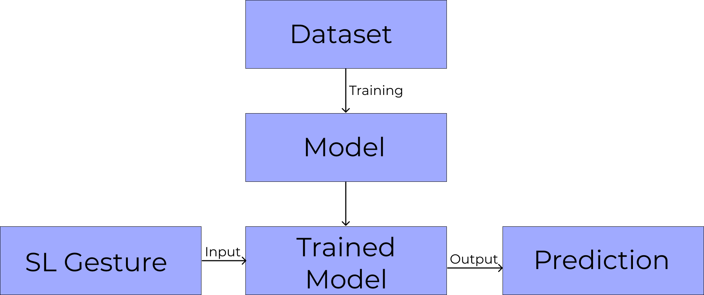
Design
Figure: High Level Design
Dept of CSE., SOE-Dayananda Sagar University
*

Slide 17
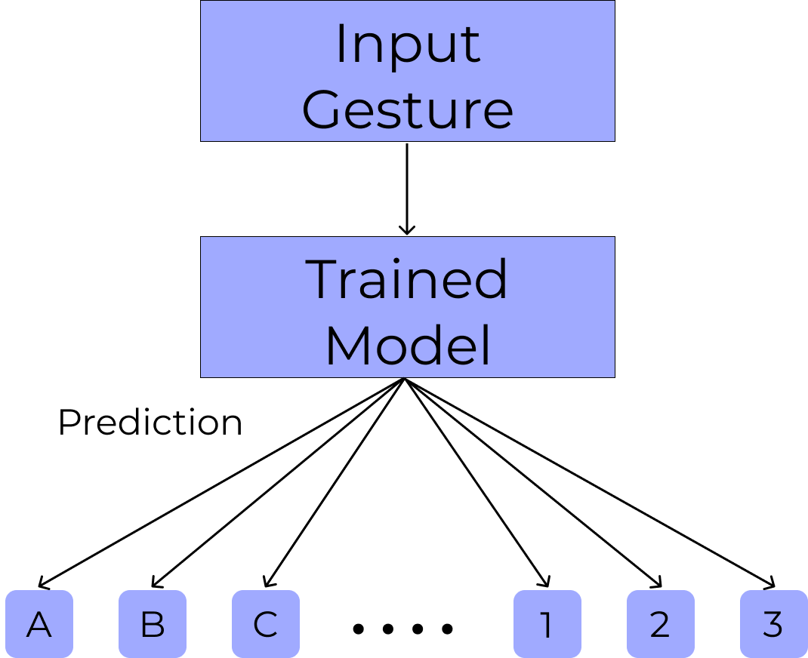
Design - Gesture to Classification
Figure: Gesture Prediction
Dept of CSE., SOE-Dayananda Sagar University
*

Slide 18
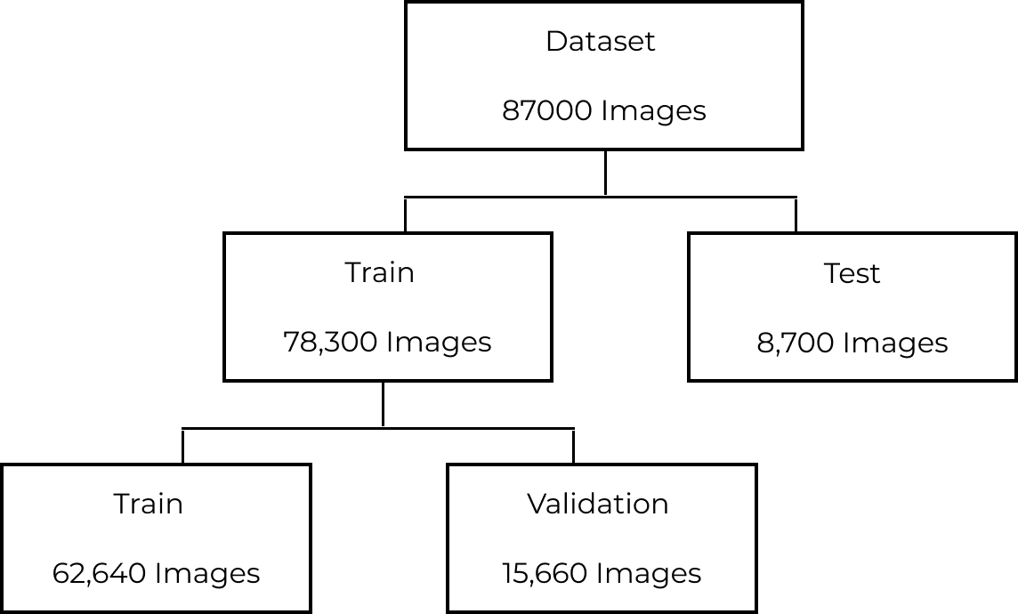
Methodology
Figure: Dataset Split
Dept of CSE., SOE-Dayananda Sagar University
*

Slide 19
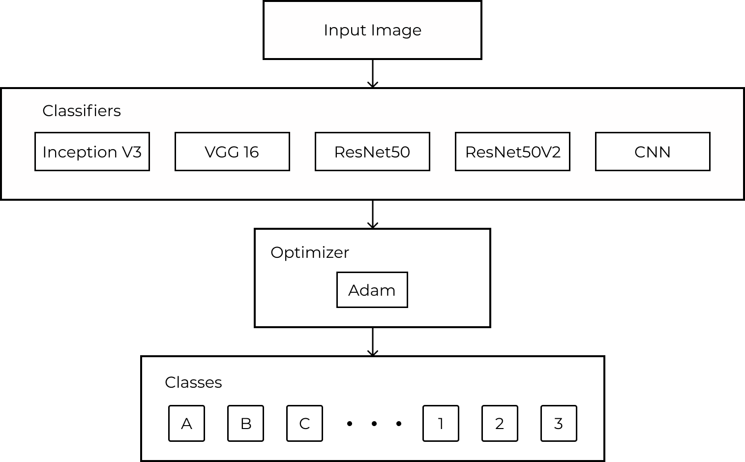
Methodology
Dept of CSE., SOE-Dayananda Sagar University
*
Figure: Model Architecture

Slide 20
Methodology
Transfer Learning is the reuse of a model on a problem that is different from the original one that it was previously developed and trained for.
The benefits include shorter training times to develop models that work well in most cases
The transfer learning models are developed using the above pre-trained models and the weights obtained on training them on the ImageNet dataset.
Fine-tuning these pre-existing models allows us to classify images for our specific application.
Dept of CSE., SOE-Dayananda Sagar University
*

Slide 21
Experimentation
During initial implementation, the RAM provided by Google Colaboratory (Free Tier) was getting completely utilized resulting in premature halting of model fitting, this was solved by halving the dataset and refitting the dataset on the models.
Low accuracy of models. This was due to incorrect model fitting, this was easily fixed by making minor adjustments to how the model was using the dataset.
Dataset Split. Initially since the splitting was not random, the last few image samples used for validation (which were taken under darker lighting conditions compared to the rest of the set) would result in a very low validation accuracy. Compiling the dataset into a Pandas Dataframe and splitting it with the help of the Scikit Learn ‘train_test_split’ method helped overcome this issue.
Dept of CSE., SOE-Dayananda Sagar University
*

Slide 22
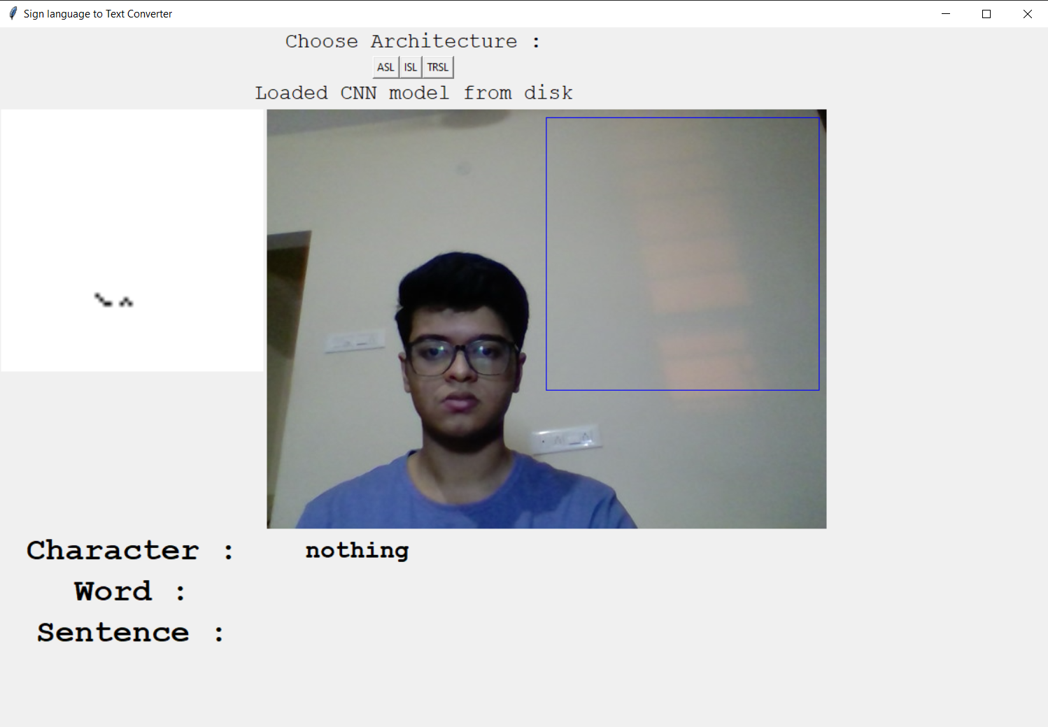
Output
Default Result(With no signs)

Slide 23
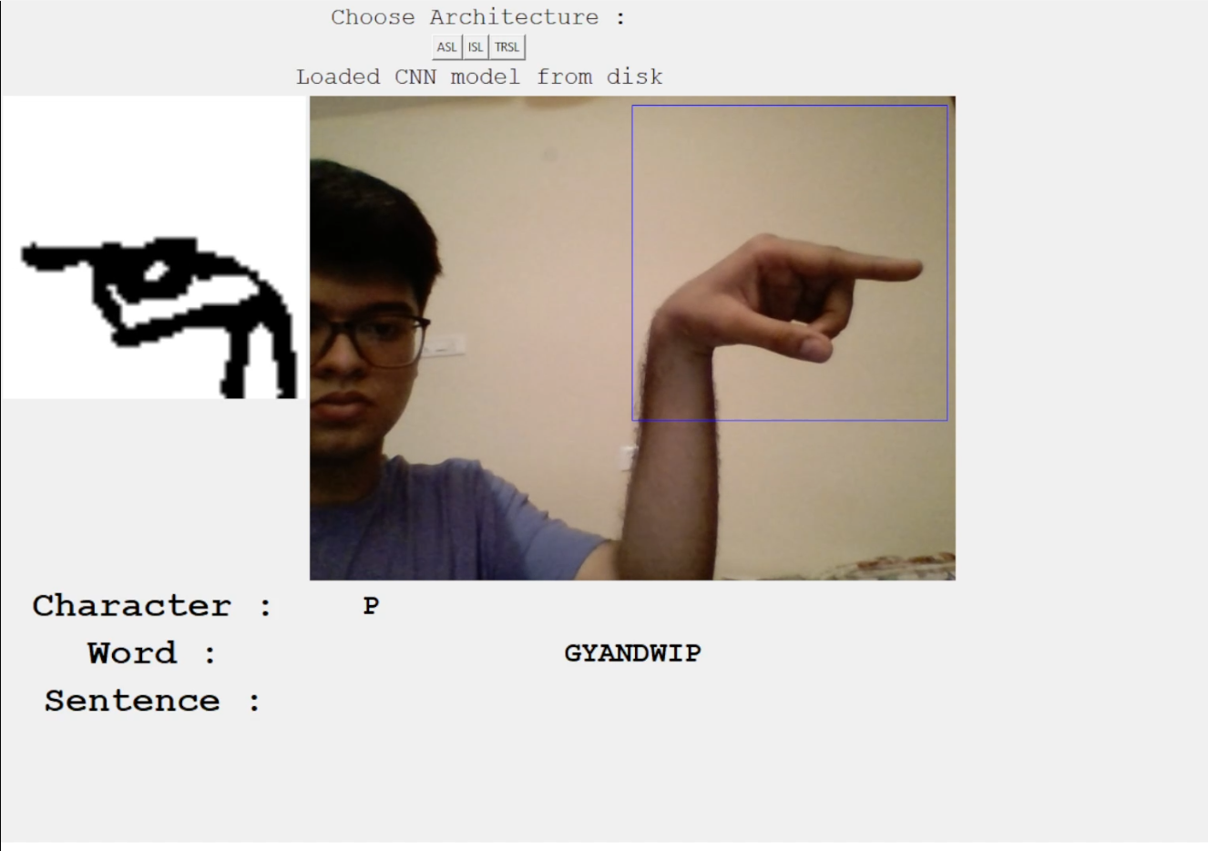
Output
Result With one word

Slide 24
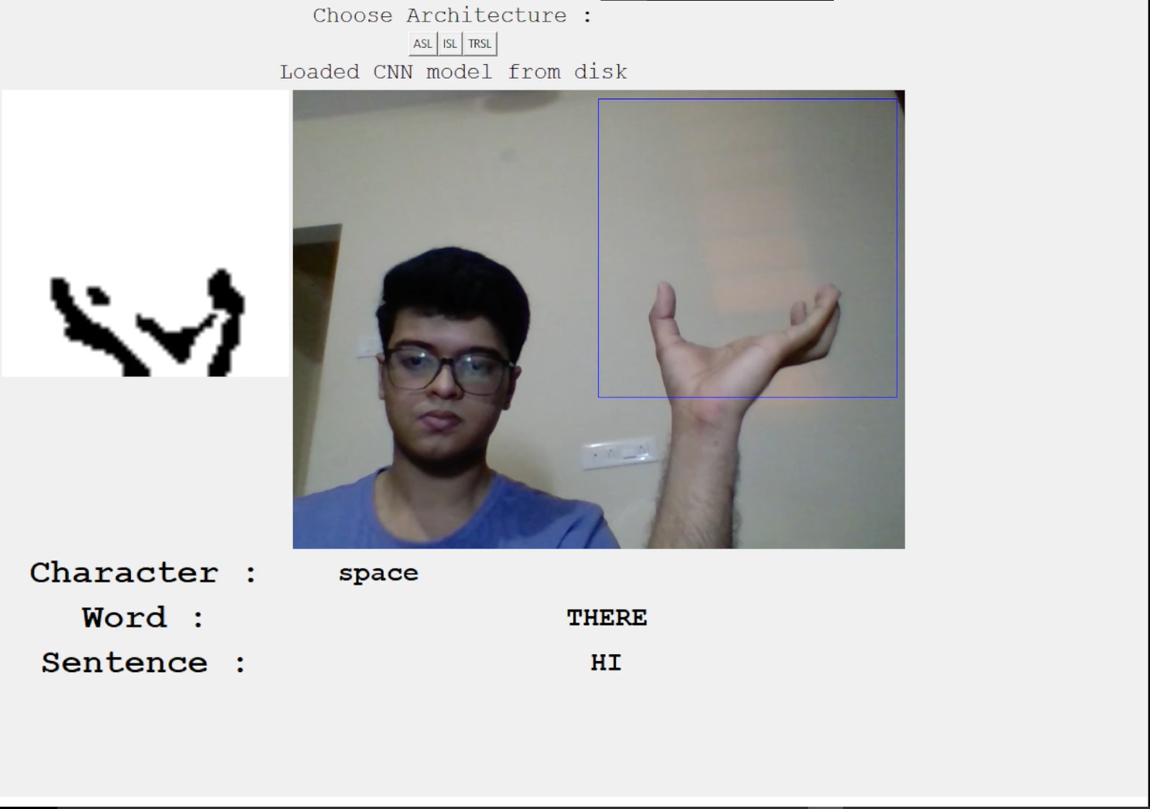
Output
Result with Sentence

Slide 25
Testing and Results
American Sign Language
 | Training Accuracy | Validation Accuracy | Test Accuracy
ResNet50 | 59.35 | 64.95 | 65.0
Resnet50 V2 | 99.37 | 99.54 | 100
VGG 16 | 96.91 | 98.67 | 99.0
Inception V3 | 98.21 | 98.61 | 99.0
CNN | 93.71 | 94.39 | 94
CNN(With Thresholding) | 99.34 | 98.9 | 99
Table: Model Accuracies
*
Dept of CSE., SOE-Dayananda Sagar University

Slide 26
Testing and Results
Indian Sign Language
 | Training Accuracy | Validation Accuracy | Test Accuracy
ResNet50 | 97.13 | 99.23 | 99.0
Resnet50 V2 | 99.99 | 100 | 100
VGG 16 | 100 | 100 | 100
Inception V3 | 100 | 100 | 100
CNN (With Thresholding) | 100 | 100 | 100
Table: Model Accuracies
Dept of CSE., SOE-Dayananda Sagar University
*

Slide 27
Testing and Results
Turkish Sign Language
 | Training Accuracy | Validation Accuracy | Test Accuracy
ResNet50 | 30.02 | 33.00 | 33.00
Resnet50 V2 | 95.61 | 90.67 | 91
VGG 16 | 91.85 | 93.8 | 94.0
Inception V3 | 83.34 | 84.6 | 84.0
CNN (With Thresholding) | 92.74 | 80.13 | 79
Table: Model Accuracies
Dept of CSE., SOE-Dayananda Sagar University
*

Slide 28
References
[1]Rajarshi Bhadra and Subhajit Kar in 2021, “Sign Language Detection from Hand Gesture Images using Deep Multi-layered Convolution Neural Network” in IEEE Second International Conference on Control, Measurement and Instrumentation (CMI).
[2]Md. Jahangir Hossein and Md. Sabbir Ejaz - “Recognition of Bengali Sign Language using Novel Deep CNN.” in 2020 2nd International Conference on Sustainable Technologies for Industry 4.0.
[3]Manuel Eugenio Morocho Cayamcela and Wansu Lim in 2019, “Fine-tuning a pre-trained Convolutional Neural Network Model to translate American Sign Language in Real-time” in International Conference on Computing, Networking and Communications (ICNC).
Dept of CSE., SOE-Dayananda Sagar University
*

Slide 29
[4]Aditya Das, Shantanu Gawde, Khyati Suratwala1 and Dr. Dhananjay Kalbande in 2018, “Sign Language Recognition Using Deep Learning on Custom Processed Static Gesture Images” in International Conference on Smart City and Emerging Technology (ICSCET).
[5]Kshitij Bantupalli and Ying Xie in 2018, “American Sign Language Recognition using Deep Learning and Computer Vision” in IEEE International Conference on Big Data (Big Data).
[6]Murat Taskiran, Mehmet Killioglu and Nihan Kahraman in 2018, “A Real-Time System For Recognition Of American Sign Language By Using Deep Learning” in 41st International Conference on Telecommunications and Signal Processing (TSP).

Slide 30
[7]Saleh Ahmad Khan, S. M. Asaduzzaman, Amit Debnath Joy, and Morsalin Hossain in 2019, “An Efficient Sign Language Translator Device Using Convolutional Neural Network and Customized ROI Segmentation” in 2nd International Conference on Communication Engineering and Technology (ICCET).
[8]Mark Borg and Kenneth P. Camilleri in 2019, “Sign Language Detection “In The Wild” with Recurrent Neural Networks” in ICASSP IEEE International Conference on Acoustics, Speech and Signal Processing (ICASSP).
[9]Jinalee Jayeshkumar Raval and Ruchi Gajjar in 2021, “Real-time Sign Language Recognition using Computer Vision” in 3rd International Conference on Signal Processing and Communication (ICPSC).

Slide 31
[10]Siming He in 2019, “Research of a Sign Language Translation System Based on Deep Learning” in International Conference on Artificial Intelligence and Advanced Manufacturing (AIAM).
[11]Gaurav Labhane, Rutuja Pansare, Saumil Maheshwari, Ritu Tiwari and Anupam Shukla in 2020, “Detection of Pediatric Pneumonia from Chest X-Ray Images using CNN and Transfer Learning” in 3rd International Conference on Emerging Technologies in Computer Engineering: Machine Learning and Internet of Things (ICETCE-2020)
[12]Kaiming He, Xiangyu Zhang, Shaoqing Ren and Jian Sun in 2016,"Deep Residual Learning for Image Recognition" in 2016 IEEE Conference on Computer Vision and Pattern Recognition

Slide 32
[13]Shruti Mohanty, Supriya Prasad, Tanvi Sinha and B. Niranjana Krupa in 2020, “German Sign Language Translation using 3D Hand Pose Estimation and Deep Learning” in 2020 IEEE REGION 10 CONFERENCE (TENCON)
[14]Gautham Jayadeep, N.V. Vishnupriya, Vyshnavi Venugopal, S. Vishnu, M. Geetha in 2020, “Mudra: Convolutional Neural Network based Indian Sign Language Translator for Banks” in 2020 4th International Conference on Intelligent Computing and Control Systems (ICICCS)
[15]Xiaoling Xia, Cui Xu, & Bing Nan. (2017). “Inception-v3 for flower classification”. 2017 2nd International Conference on Image, Vision and Computing (ICIVC).

